Slide 1
CLVR Implementation Project: Reward-Induced Representation Learning [1]
Yibin Xiong
October 14, 2021

Slide 2
Outline
Overview
Experiment Details
Results & Analysis
Reflections & Implications

Slide 3
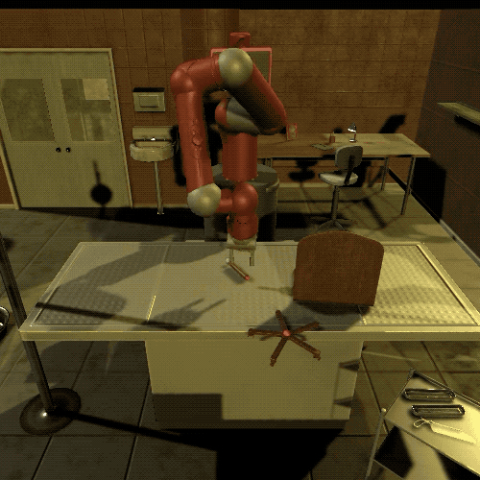
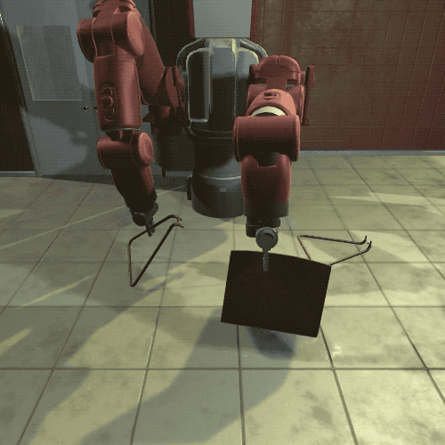
Motivation
High dimensional input
Sparse reward (most actions result in 0 reward)
Extract useful information, ignore useless information

Slide 4
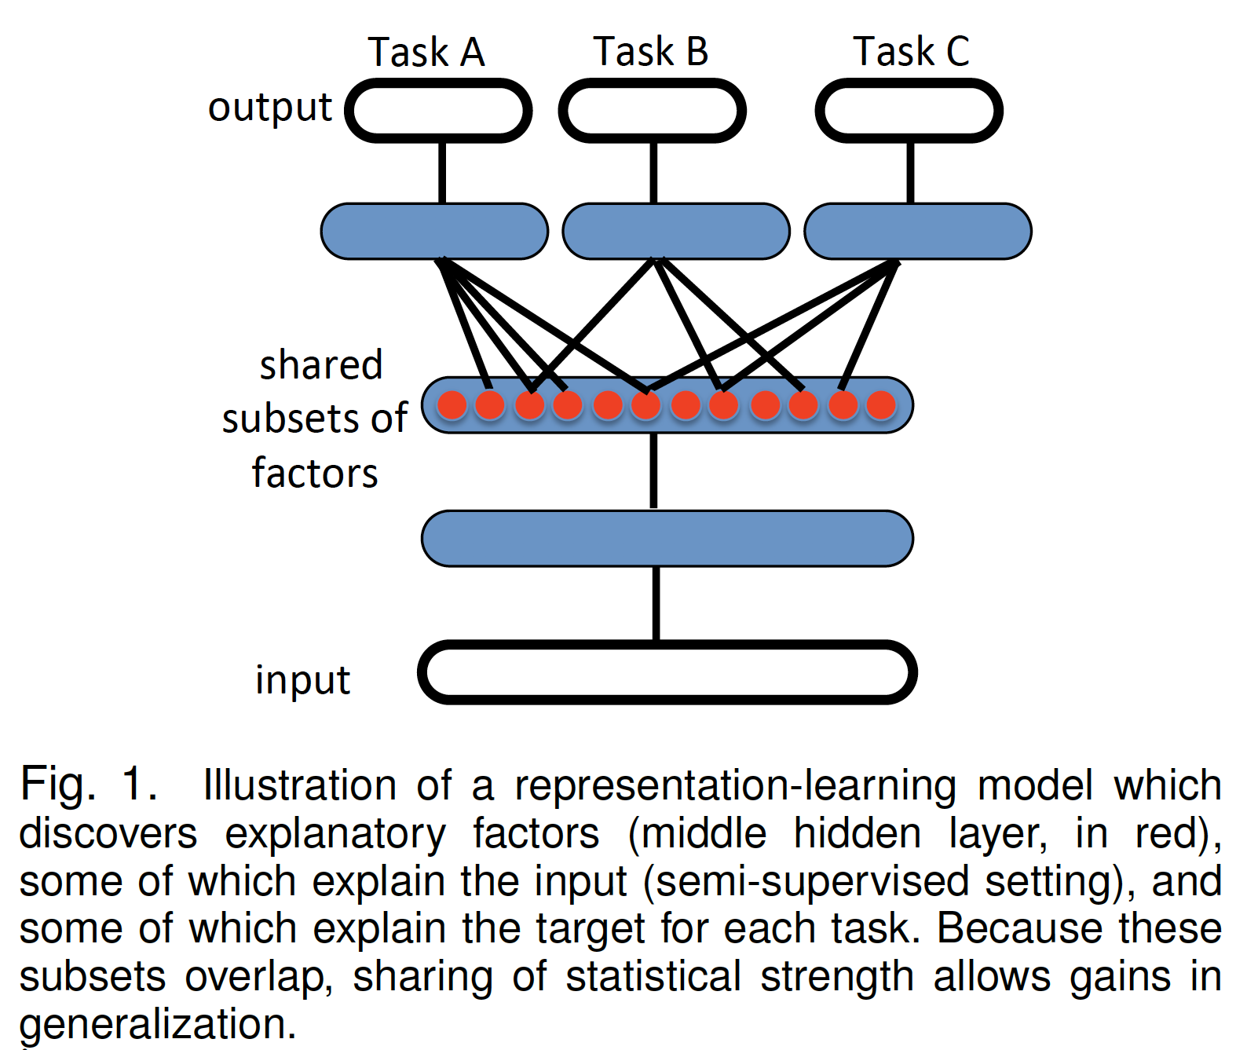
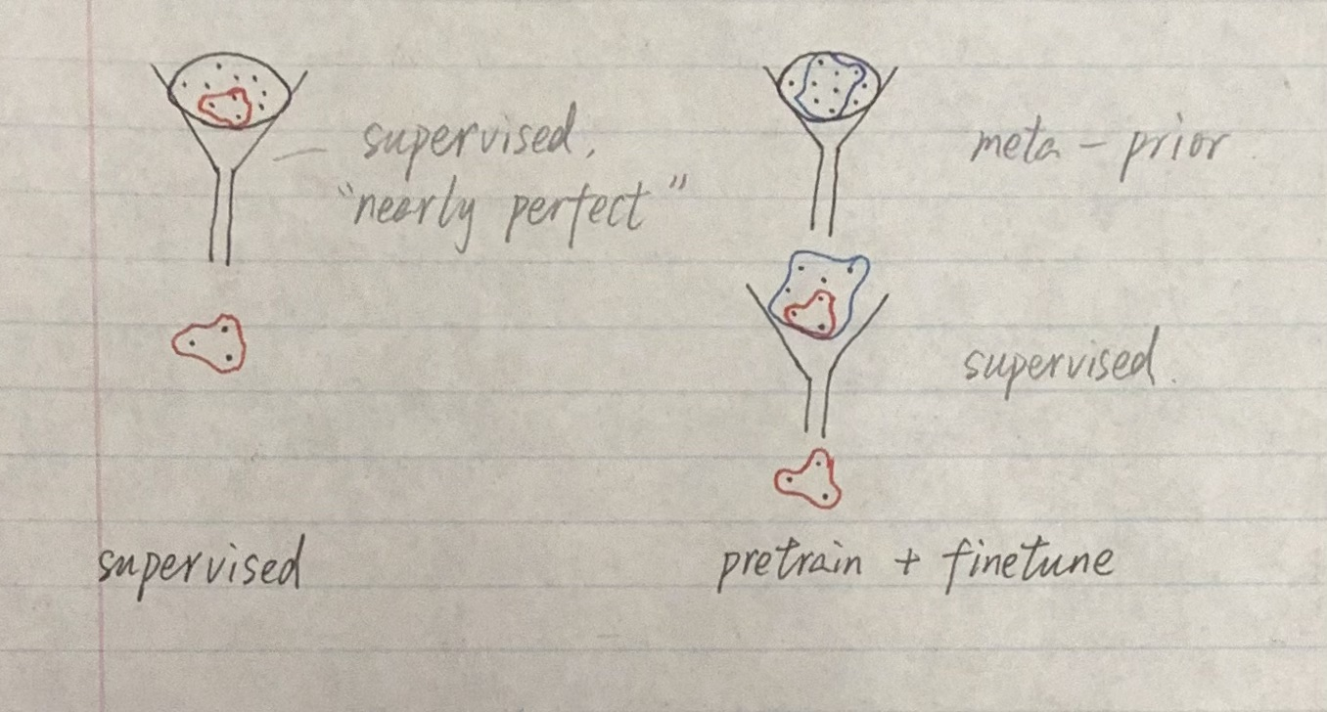
Representation Learning
Idea: find a lower-dimensional representation (encoding/feature vector) of the input that retains important information relevant to our tasks
Think about filters!

Slide 5
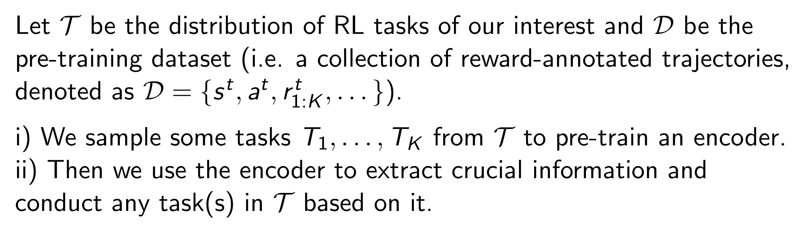
Our Scheme

Slide 6
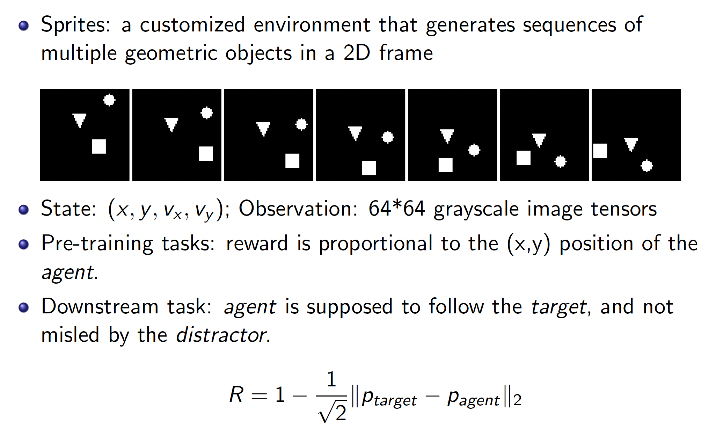
Our RL Environment: Sprites
target
distractor
agent
and target.

Slide 7
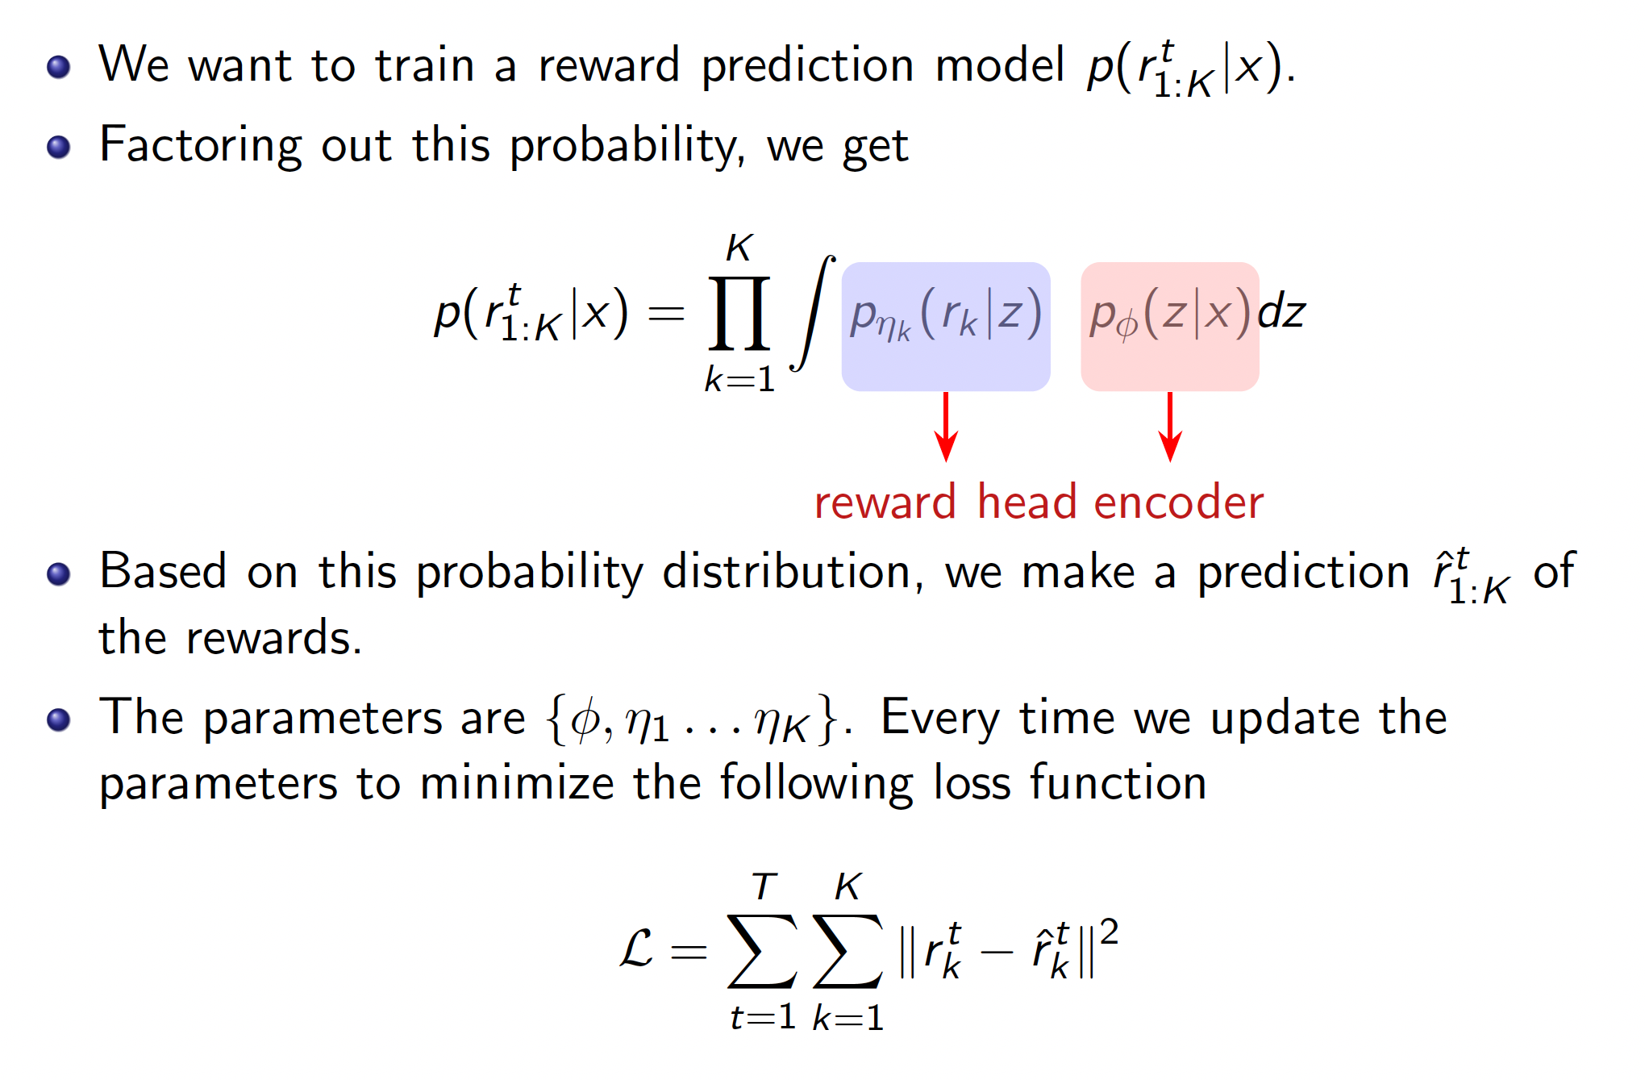
Math Formulation

Slide 8
Outline
Overview
Experiment Details
Results & Analysis
Reflections & Implications

Slide 9
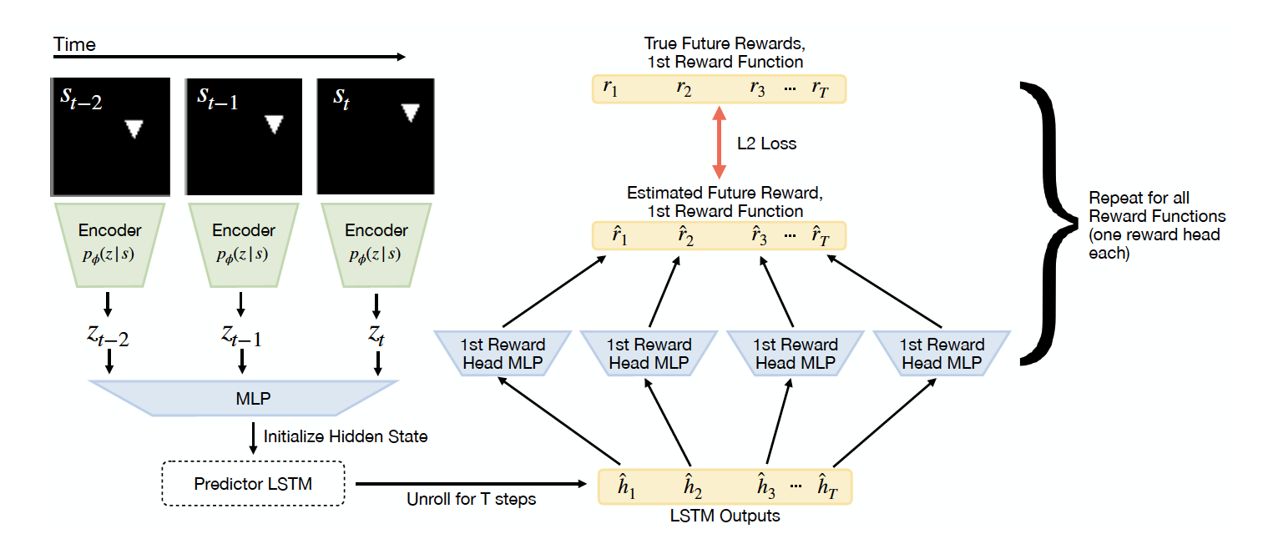
Reward-Prediction Model (Pre-training)

Slide 10

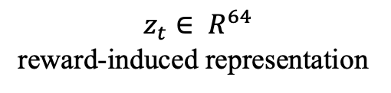

Downstream RL
trajectories in the buffer
Encoder
Encoder
Encoder
$$z_{t}∈ R^{64}$$
reward-induced representation
PPO
Policy
Value
Good Policy $π\left(a | s\right)$

Slide 11
Baselines: Using an Encoder
Reward-prediction is basically what we described. It uses reward-induced encoder
2 versions: If we update the parameters of the encoder in downstream training, it is called the reward-prediction-finetune baseline. If we freeze the encoder, it is the reward-prediction baseline.
Image-reconstruction uses the encoder trained with image reconstruction loss (pixel-wise L2 loss). Other parts are the same as reward-prediction.
Still, there are the finetuned and frozen versions.
Image-scratch adopts the same architecture as reward-prediction, but reinitializes the parameters of the reward-induced encoder.

Slide 12
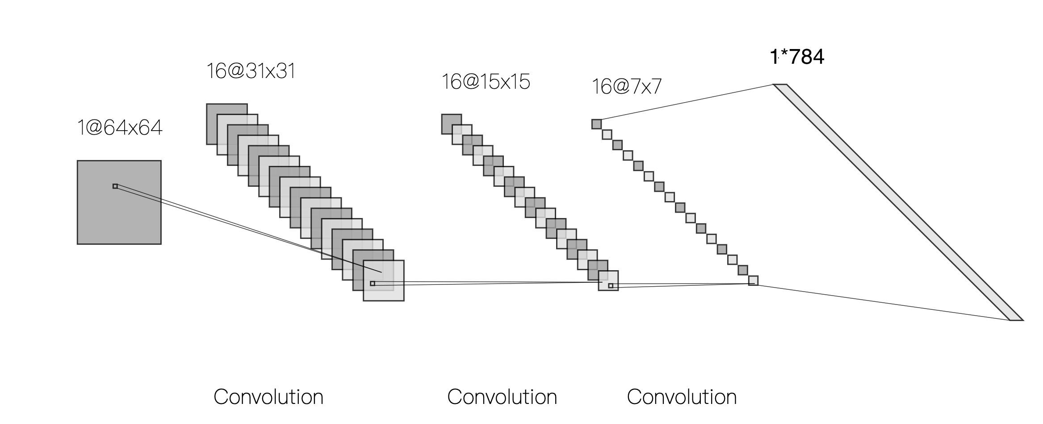
Baselines: Others
CNN uses a 3-layer ConvNet with 16 kernels of size 3*3 and stride = 2 in each layer. ReLU is used after each Conv layer. Then the output is flattened and passed to PPO.

Slide 13
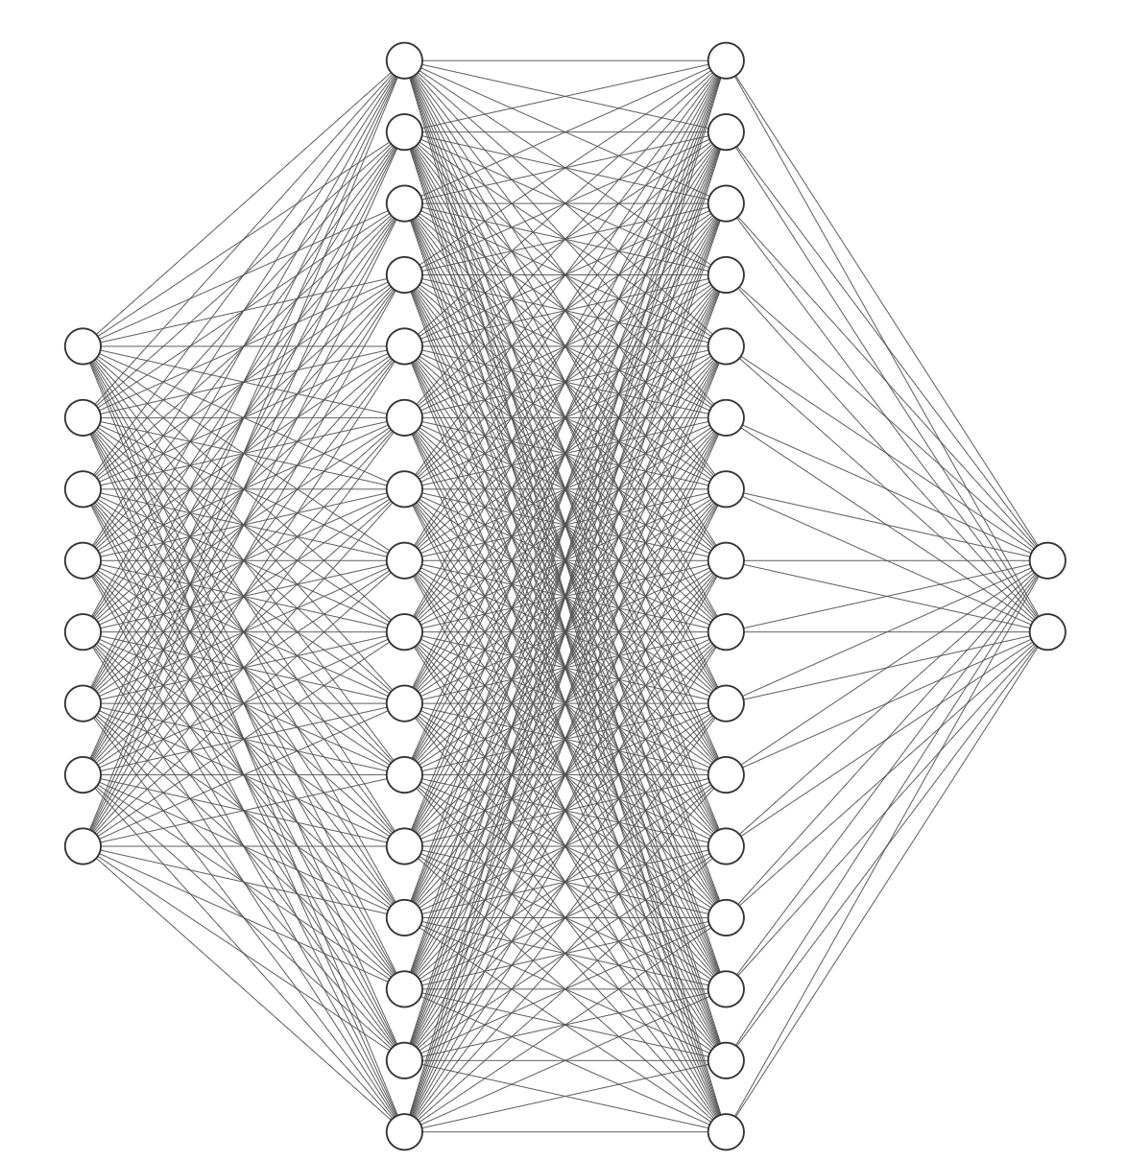
Baselines: Others
2 distractors case
32
32
Oracle uses the states (i.e. the (x, y, v_{x}, v_{y}) quadruple) of the target, agent, and distractor(s) rather than graphical observations as input.
The states are directly passed into the policy network (actor) and value network (critic) in PPO.
It is expected to have the best performance
16
2

Slide 14
Outline
Overview
Experiment Details
Results & Analysis
Reflections & Implications

Slide 15
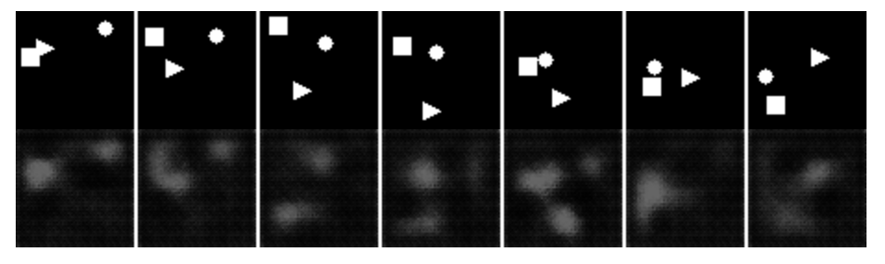
Does the reward-induced encoder capture useful information?
I append a decoder (made of transposed Conv layers) to the reward-induced encoder and train them with image reconstruction loss (pixel-wise L2). Note that the parameters of the encoder should be fixed.

Slide 16
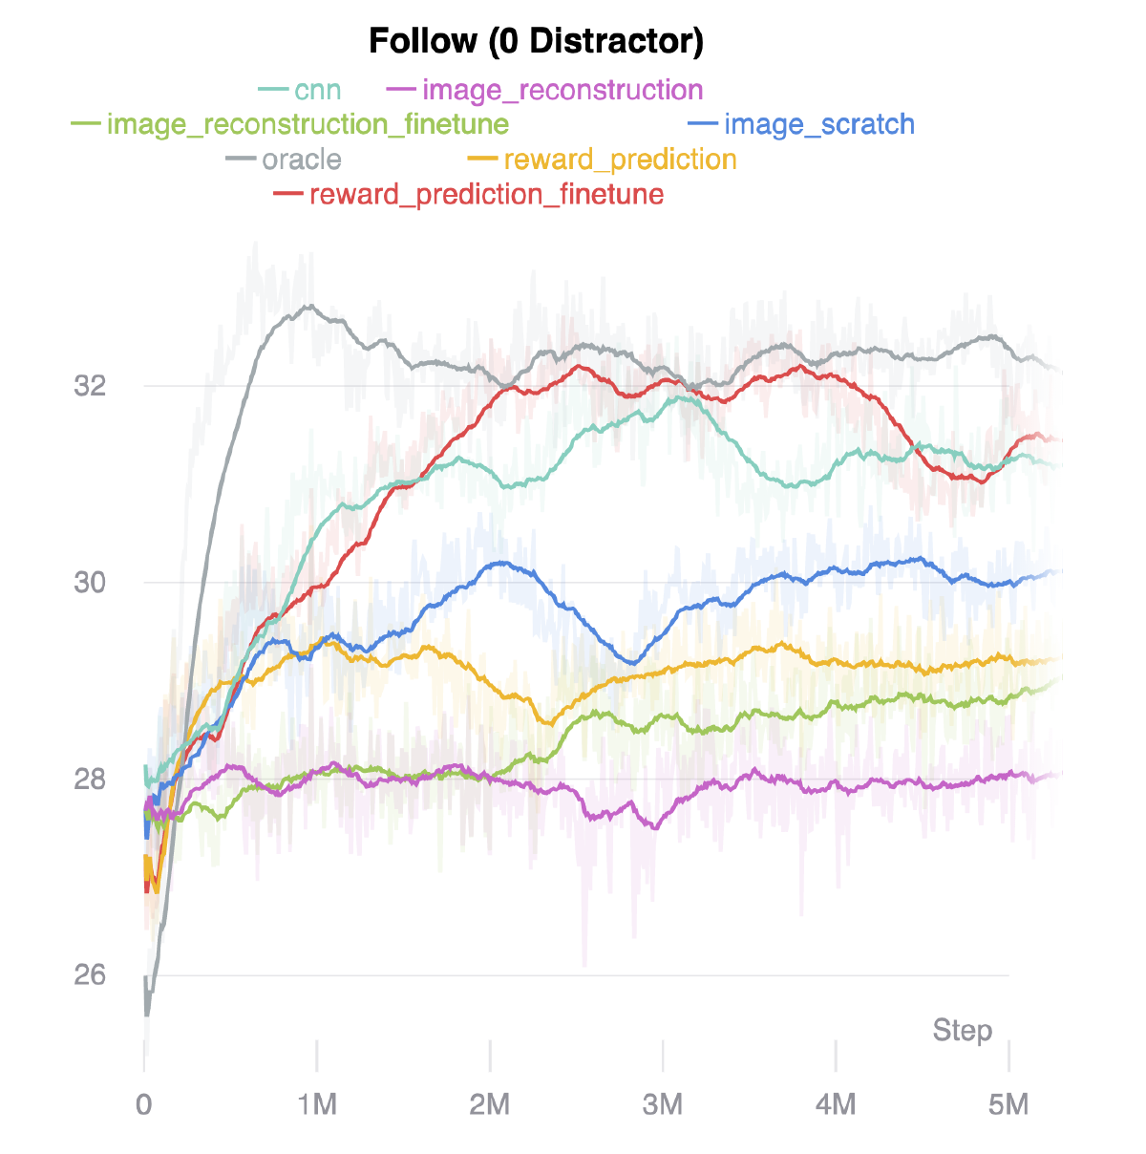
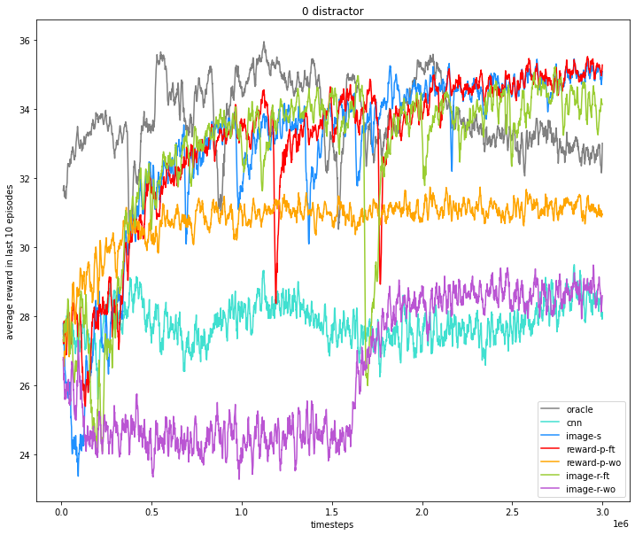
Reward Curves: 0 Distractor
Notes:
The oracle baseline degrades at about 1.5M steps and eventually it is even worse than those using reward-induced encoders.
CNN performs worse than expected (in the original paper).

Slide 17
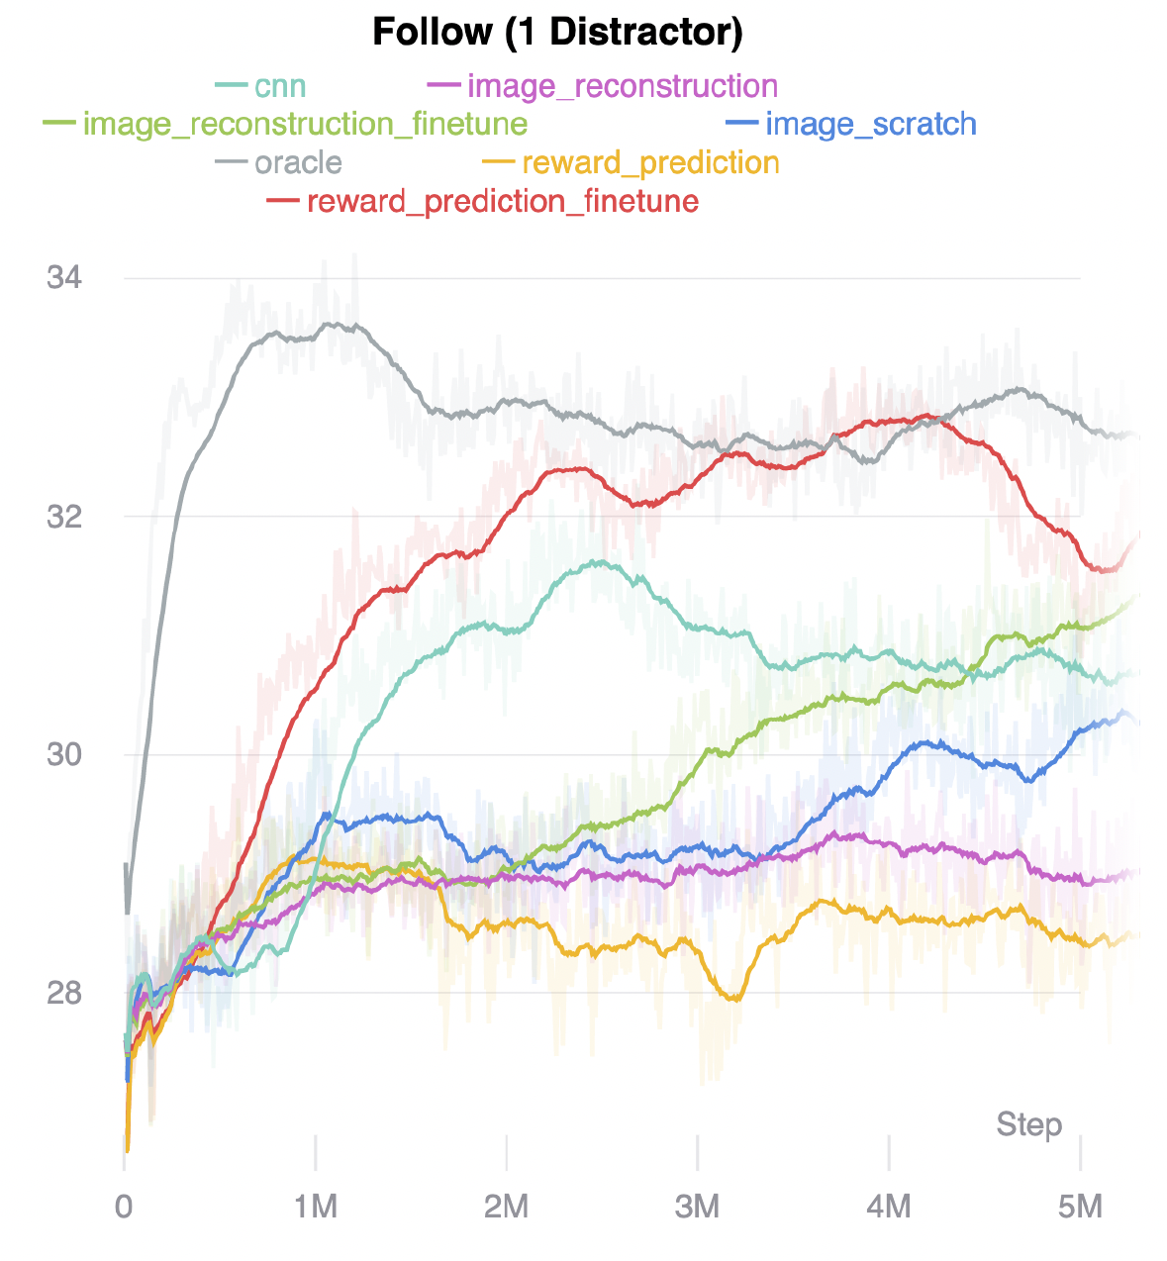
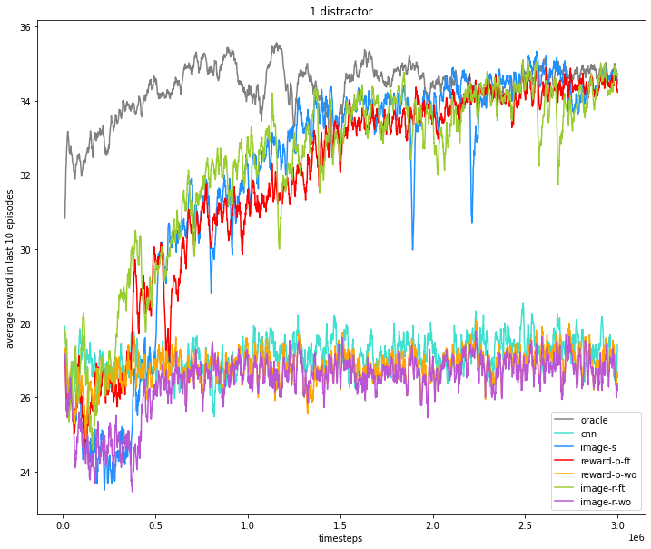
Reward Curves: 1 Distractor

Slide 18
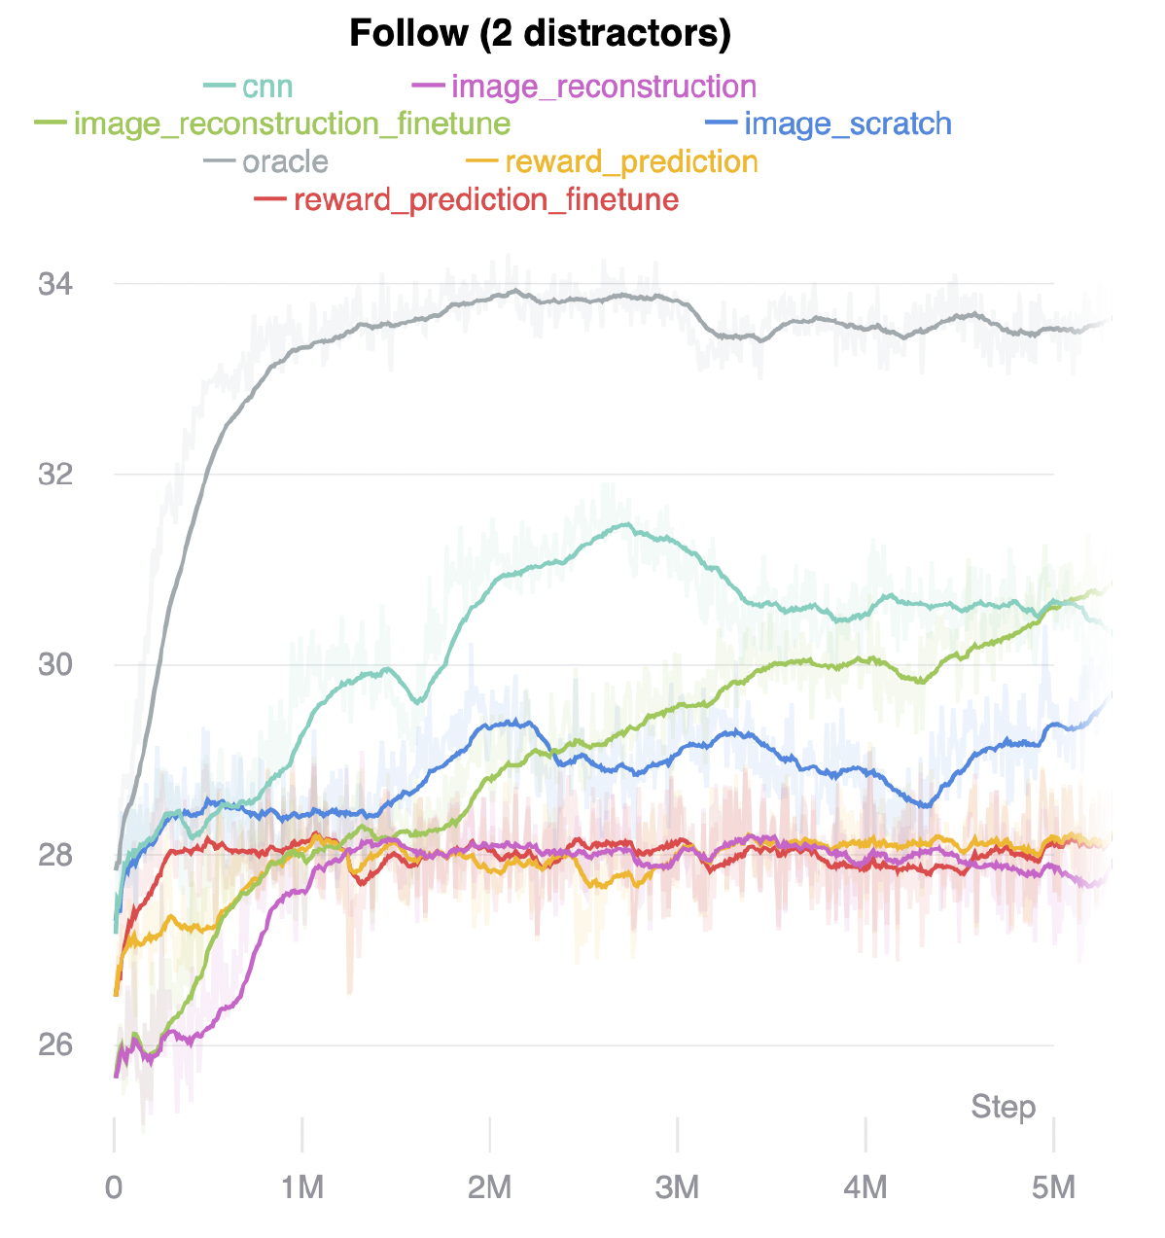
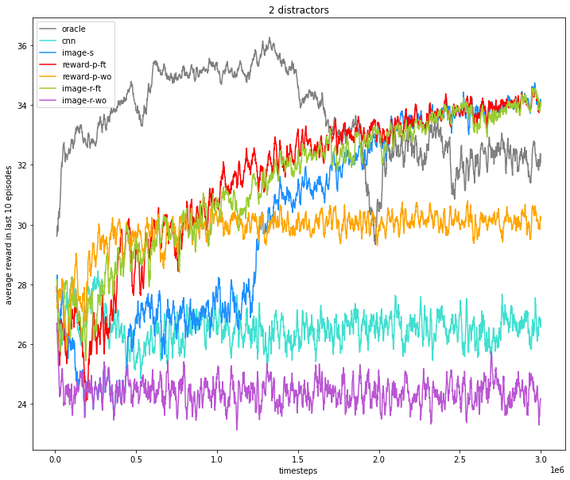
Reward Curves: 2 Distractors

Slide 19
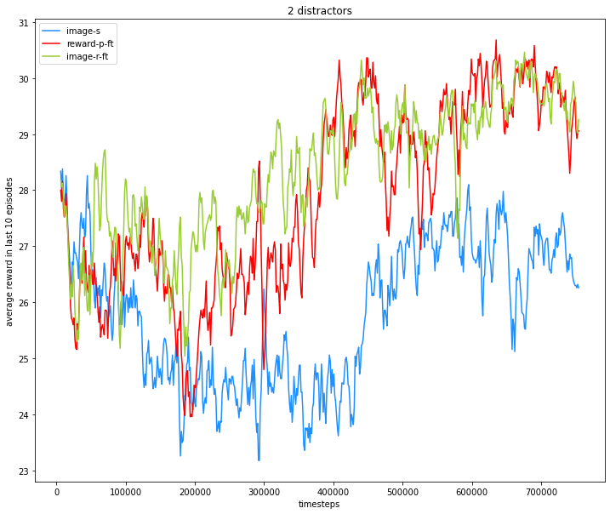
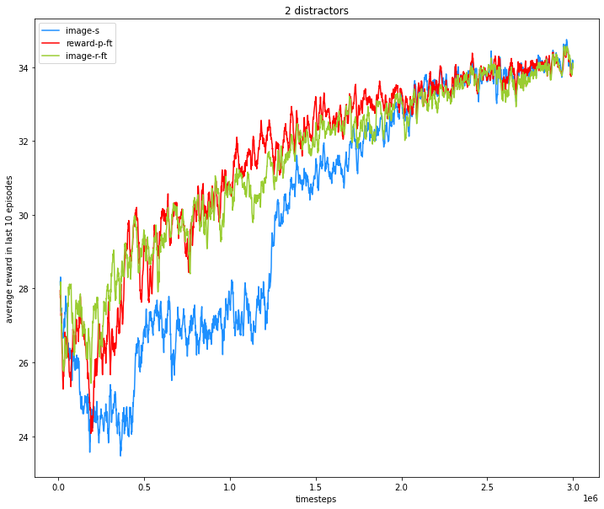
Initialization: Pretrain or NOT?
Good initialization puts you at a better starting point (closer to the desired point)
When finetuning is allowed, eventually a relatively poor initialization can achieve the same performance as the one with a better initialization
Notes:
The comparison is between image-s and (reward-p-ft & image-r-ft)
Why does initialization have regularization effects?

Slide 20
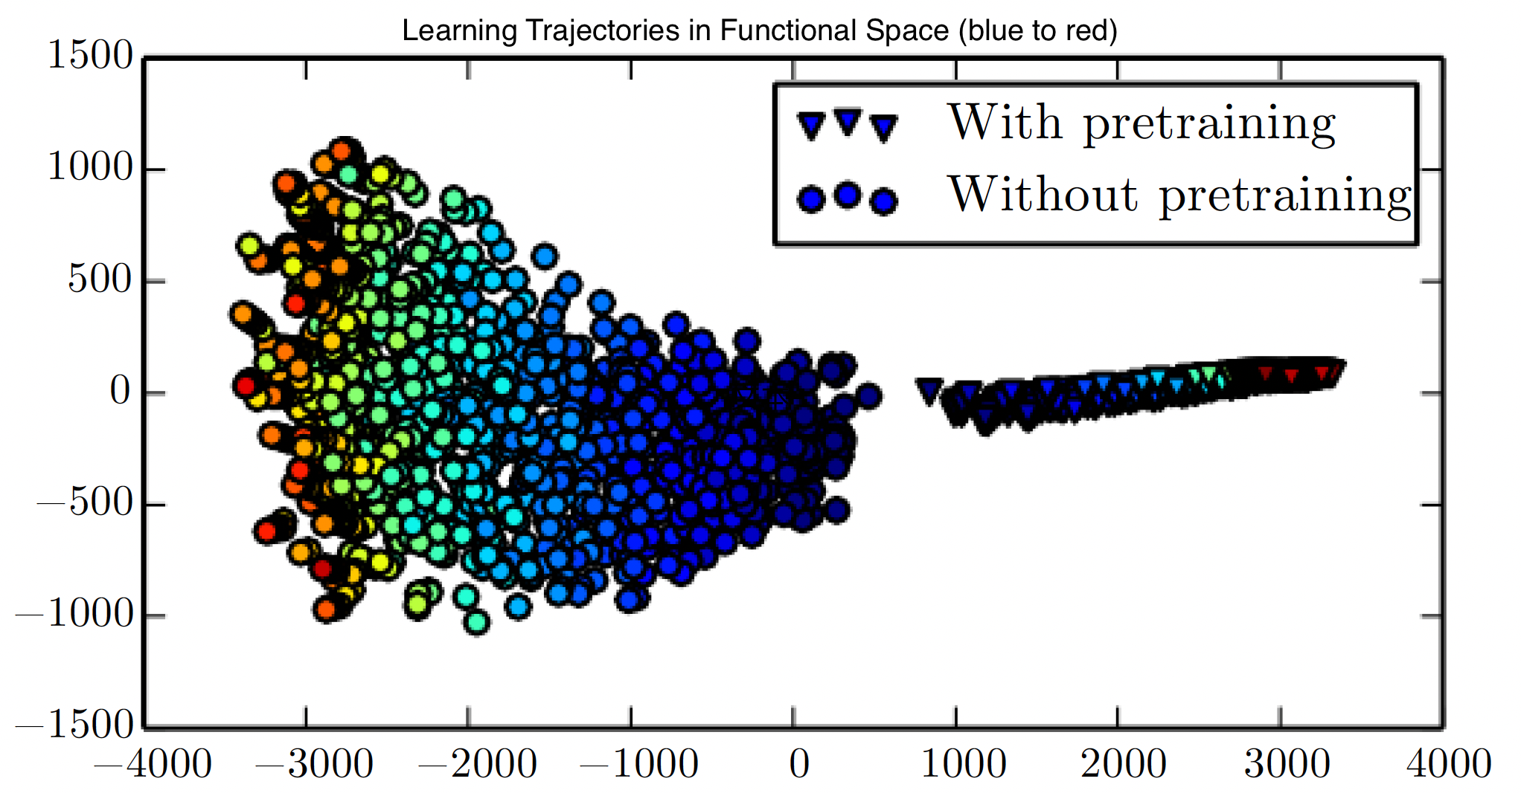
Theoretically, …
“Training from random initialization is surprisingly robust.” [2]
Our task is simple and reward signal is easily accessible. BUT pretraining helps a lot in tasks with large-scale input and/or sparse ground-truth labels.
“[ImageNet] pre-training speeds up convergence early in training…” [2]
Notes:
In the middle is uniform distribution and the more outer, the more discriminative the model is.

Slide 21
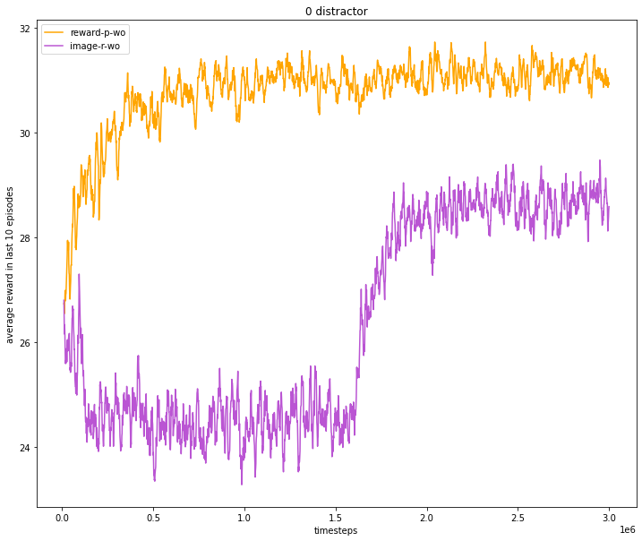
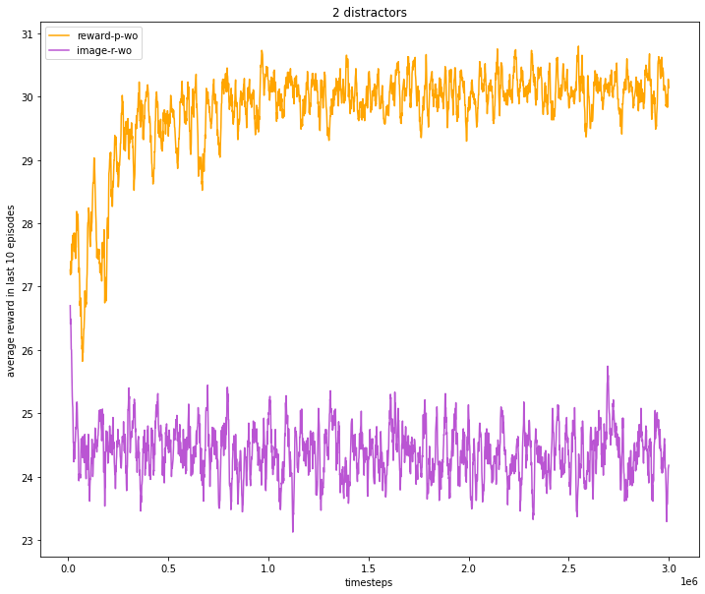
Types of Representations
Reward-induced encoder VS Image reconstruction encoder
Notes:
The comparison is between reward-p and image-r.
1 distractor case is abnormal.

Slide 22
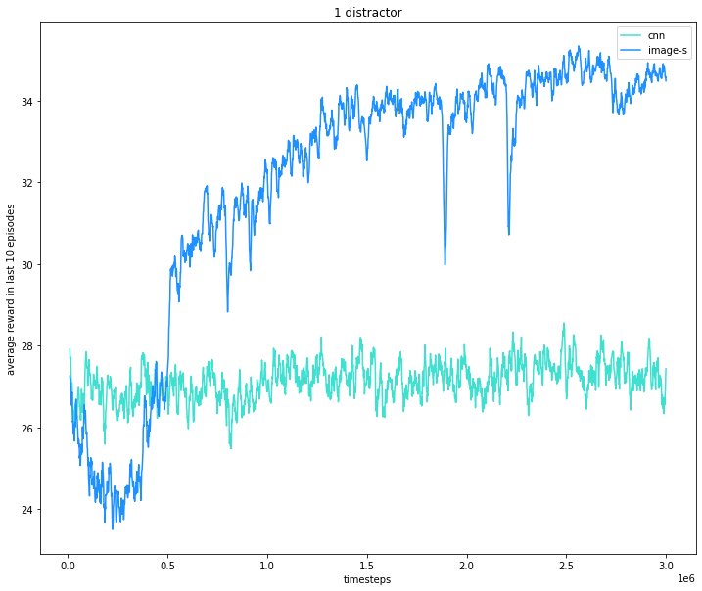
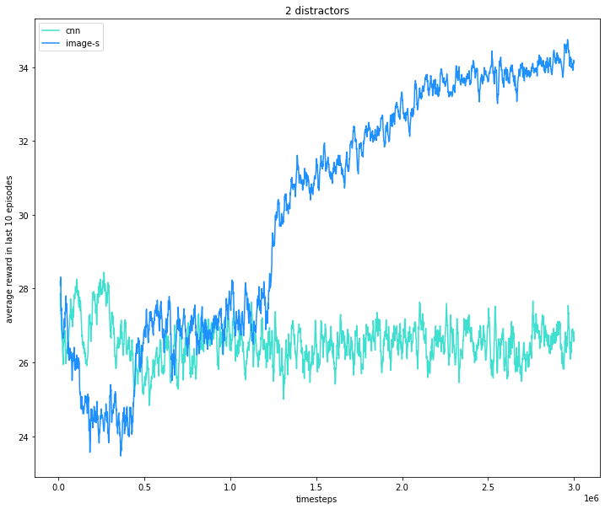
Representational Capacity of a Model
CNN (3 Conv layers) VS Image-s (Encoder: 6 Conv layers with BN + 1 MLP layer)

Slide 23
Opposite Conclusion?
“Note that cnn performs better than image_scratch because of its small sized CNN network suitable for RL.”[1]

Slide 24
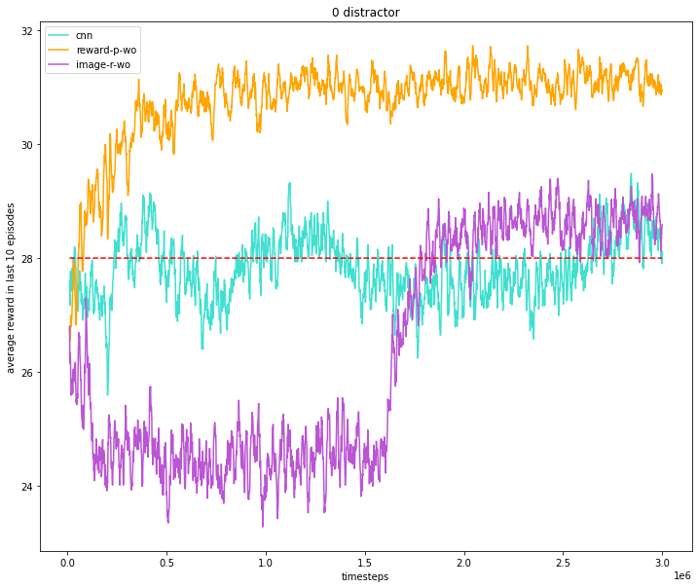
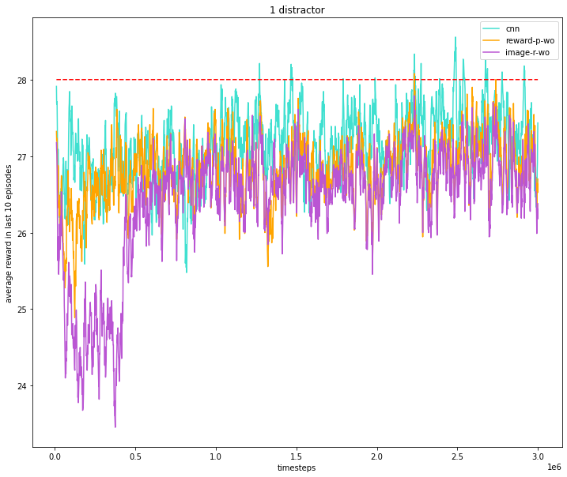
Number of Distractors
Having more distractors limits the performance of the “weaker” baseline models

Slide 25
Abnormalities
Oracle: in the 2 distractors case, oracle’s performance degrades after about 1.5M steps, eventually surpassed by those 3 with finetunable encoders.
The 3 “strong” baseline models – reward-p-ft, image-r-ft, image-s:
Performances are highly aligned in my experiment, but NOT in the original* experiment
In my experiment, reward-p-ft is robust even in the 2 distractors case, but it degrades in the original version
Sudden drops at some timesteps
Reward-p-wo: In my experiment, it performs better in the 2 distractors case than in the 1 distractor case…
CNN: seems to have good performance in the original experiment, but NOT in mine.
My reward curves have higher variance than the original ones
A wider range of rewards

Slide 26
Reward Curves: 0 Distractor
Notes:
The oracle baseline degrades at about 1.5M steps and eventually it is even worse than those using reward-induced encoders.
CNN performs worse than expected (in the original paper).

Slide 27
Reward Curves: 1 Distractor

Slide 28
Reward Curves: 2 Distractors

Slide 29
Outline
Overview
Experiment Details
Results & Analysis
Reflections & Implications

Slide 30
Variance Reduction
Try other RL algorithms: DDPG/SAC
General Advantage Estimation

Slide 31
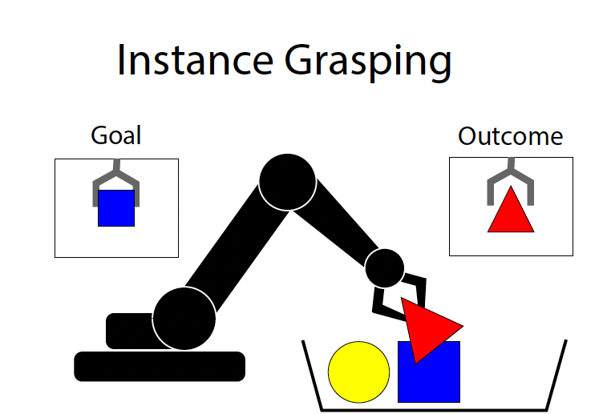
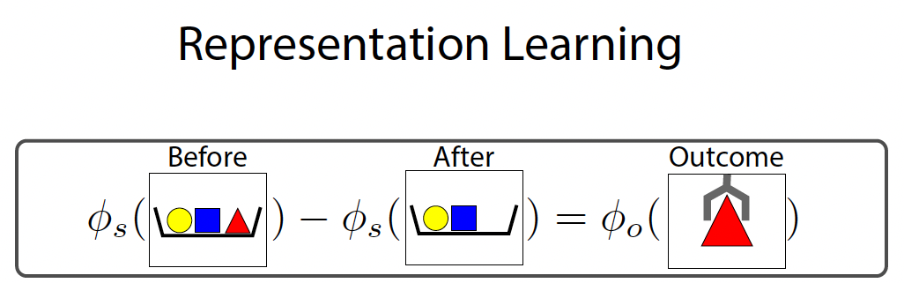
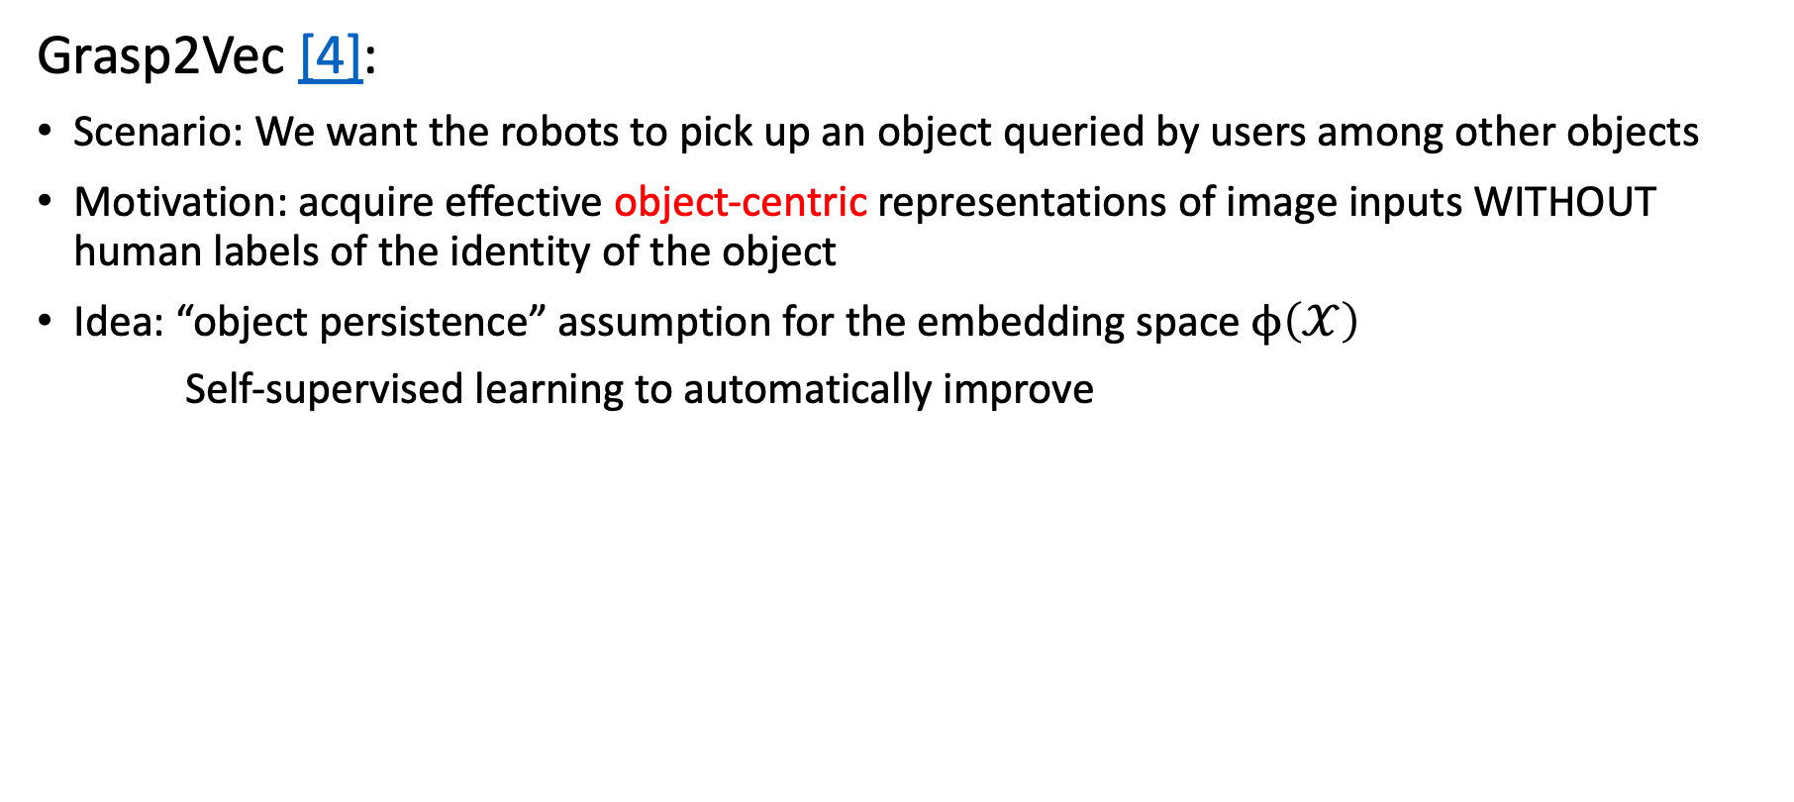
Representation Design
Grasp2Vec [4]:
Scenario: We want the robots to pick up an object queried by users among other objects
Motivation: acquire effective object-centric representations of image inputs WITHOUT human labels of the identity of the object
Idea: “object persistence” assumption for the embedding space $ϕ\left(𝒳\right)$
Self-supervised learning to automatically improve

Slide 32
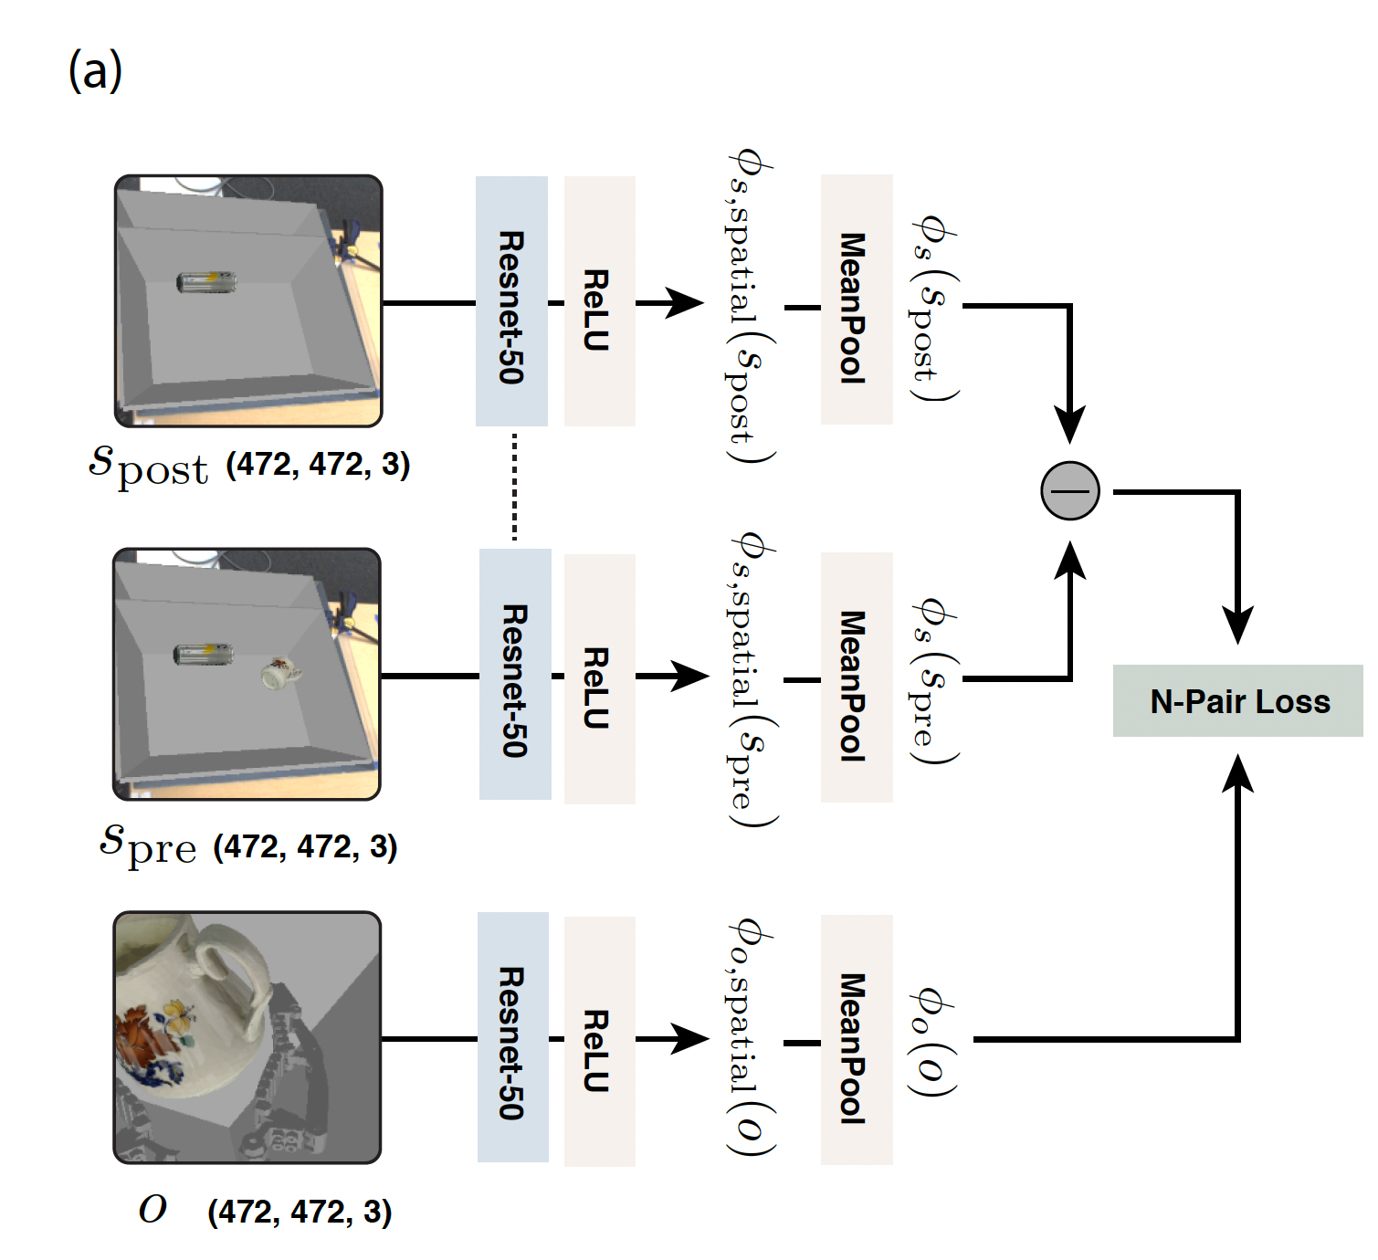
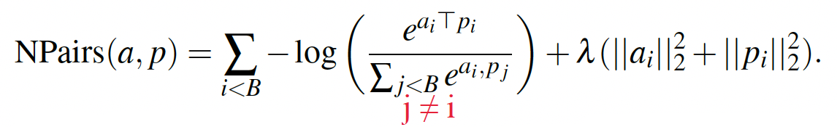
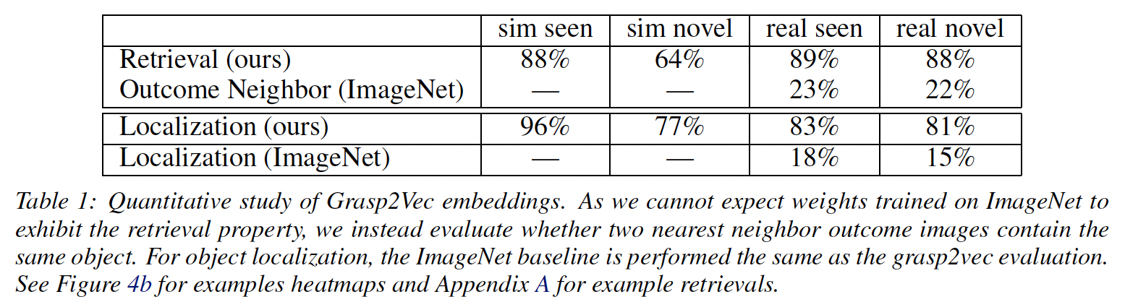
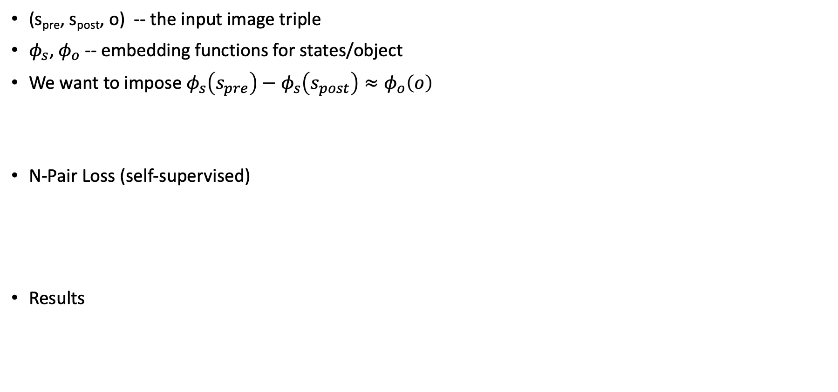
Representation Design
(s_{pre}, s_{post}, o) -- the input image triple
$φ_{s}$, $φ_{o}$ -- embedding functions for states/object
We want to impose $φ_{s}\left(s_{pre}\right)−φ_{s}\left(s_{post}\right)≈φ_{o}\left(o\right)$
N-Pair Loss (self-supervised)
Results
“positive”
“anchor”

Slide 33
What can we do with Representation Learning?
Dimension Reduction
Few-shot Learning
Transfer Learning: domain/task adaption
NLP pre-trained language models – BERT, GPT

Slide 34
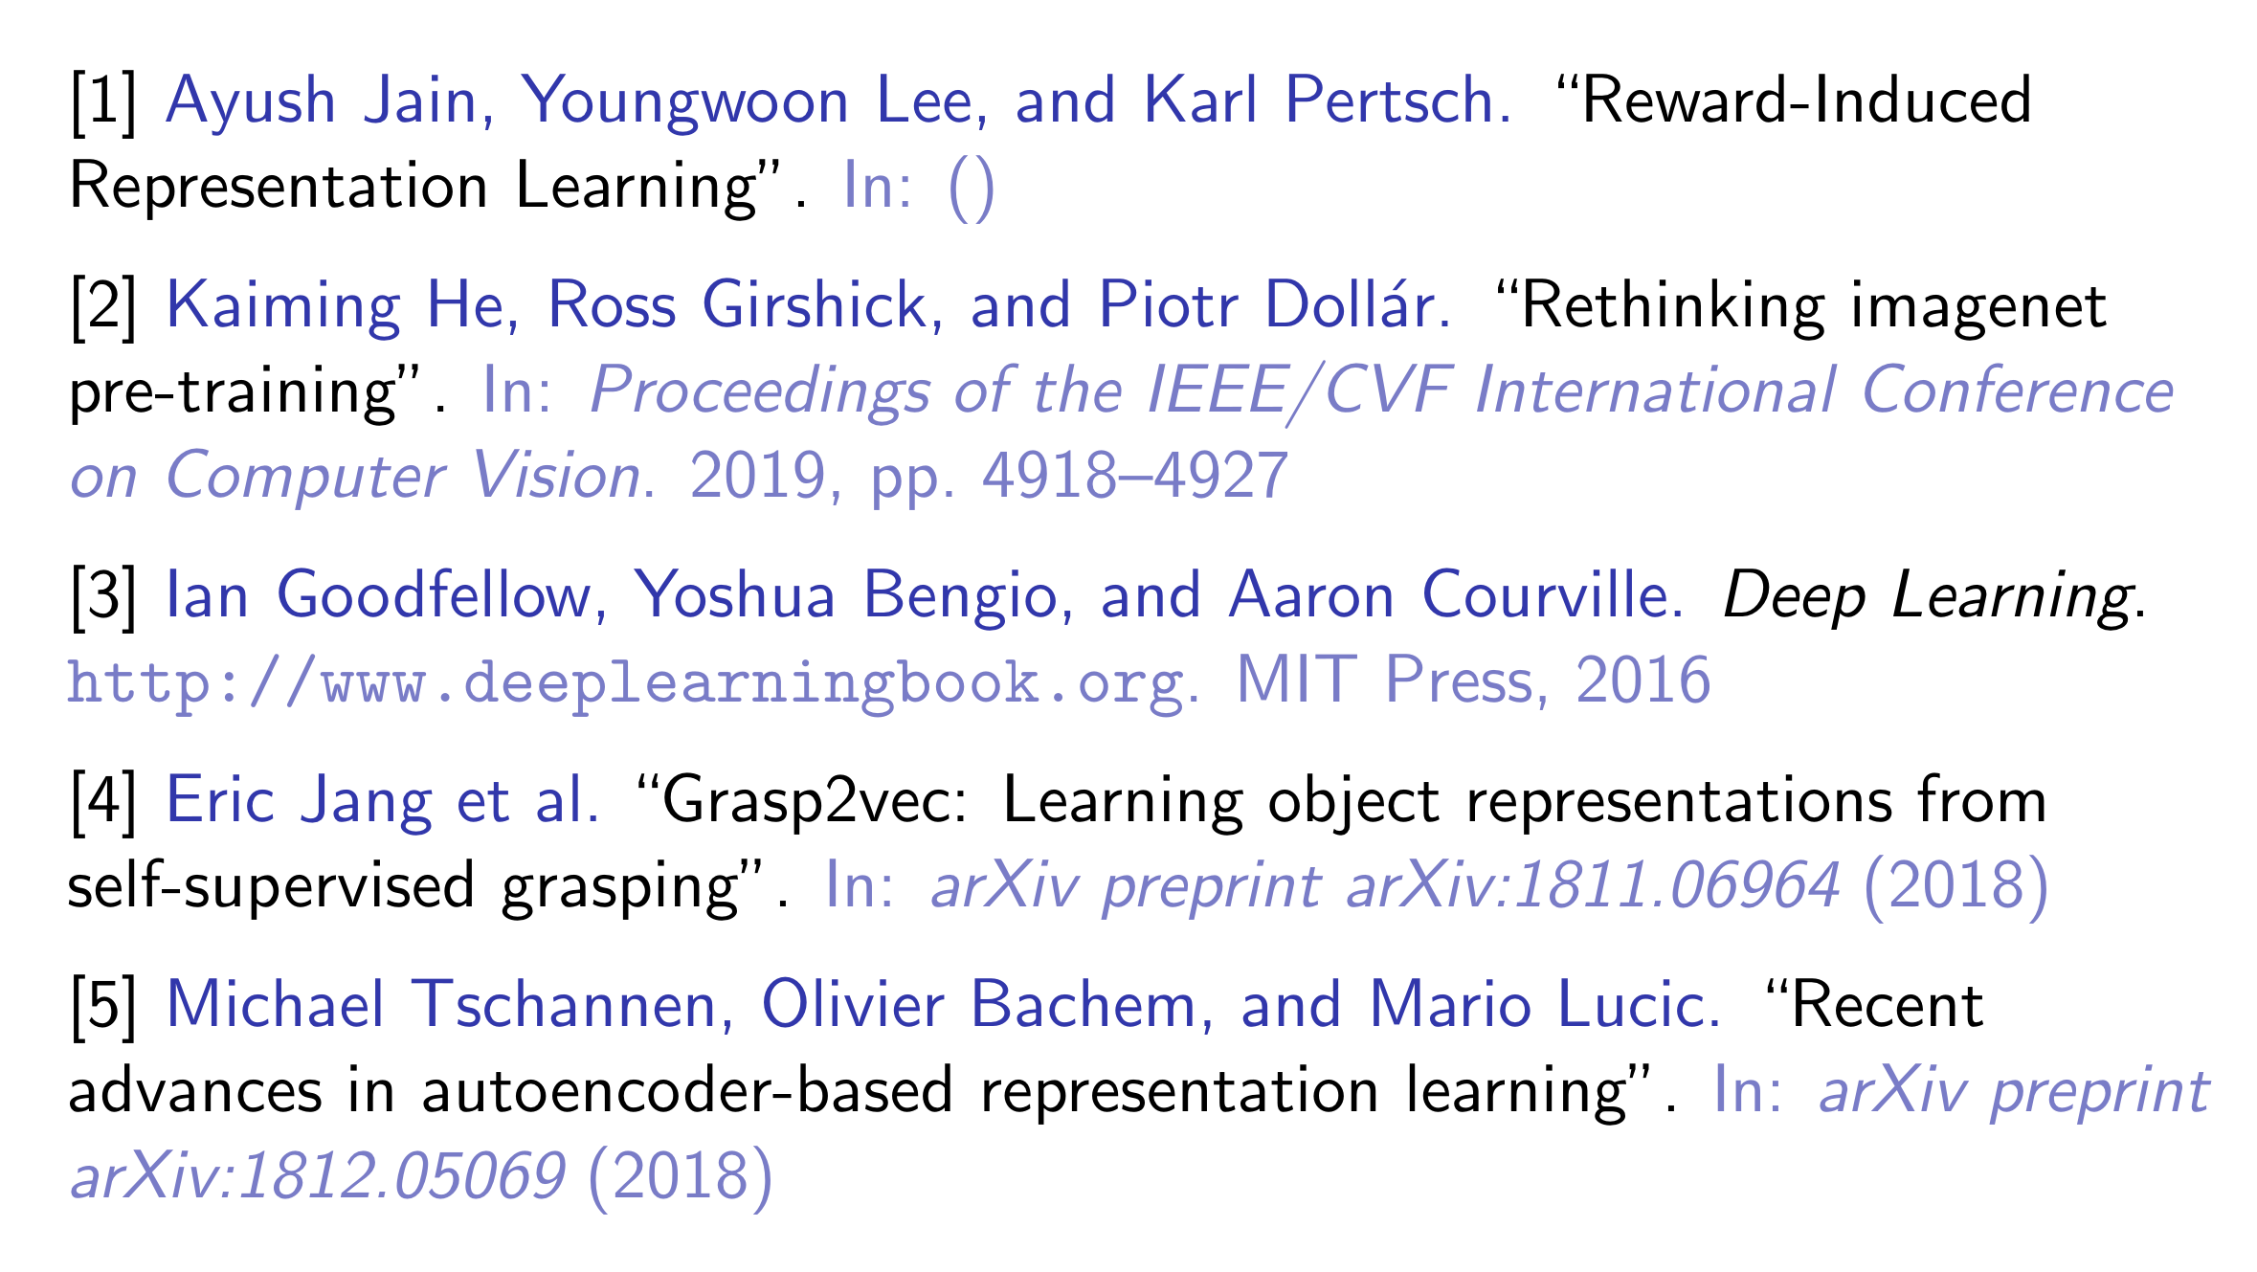
References

Slide 35
Thank you!

